Slide 1

key metrics being tracked based on the health impact (COVID-19) in kingdom of Saudi Arabia and United states of America
A project accomplished by Akhmedova Shakhnoza

Slide 2
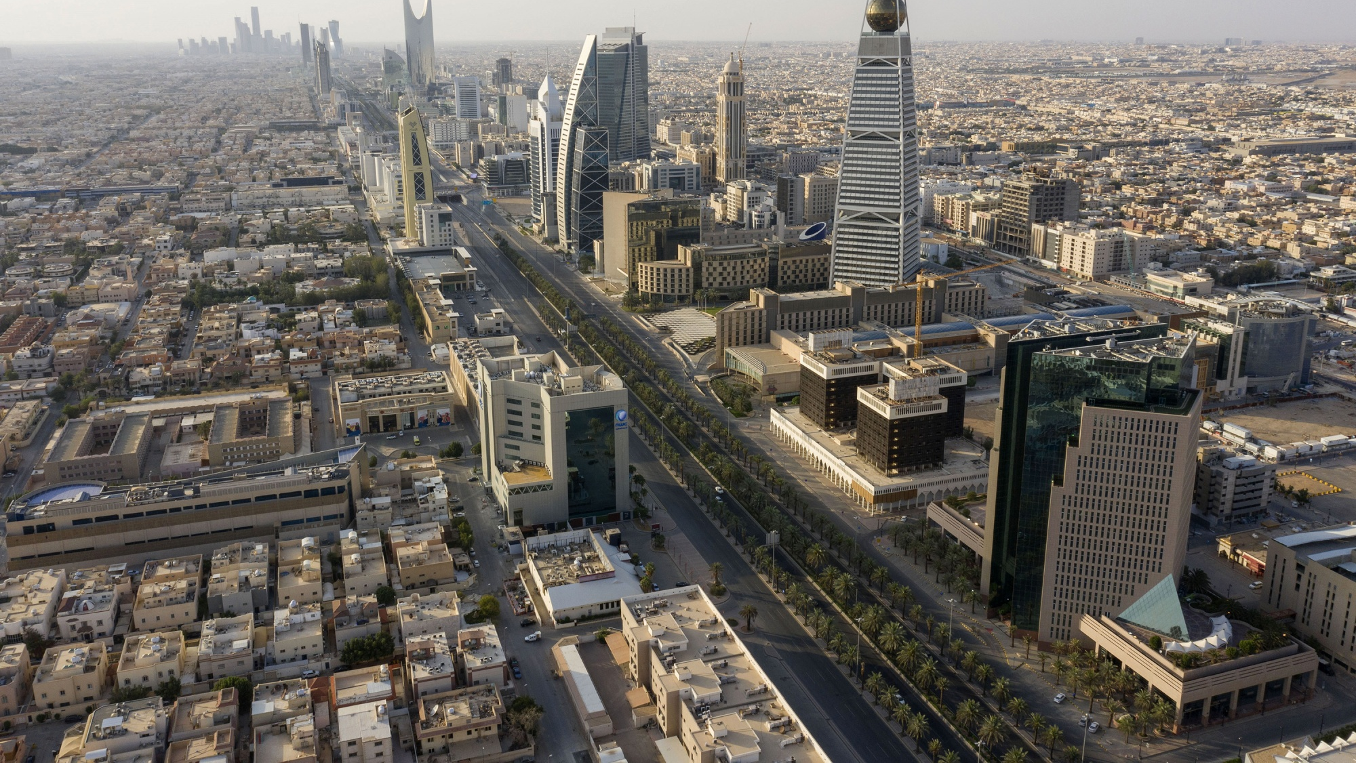
Covid-19 worldwide statistics: Country of origin: china, Wuhan, December, 2019 impacting economies, food systems, supply chains and health security. The World Health Organization declared COVID-19 (SARS-CoV-2) a Public Health Emergency of International Concern on 1st February, 2020. Demographical proliferation: Asia, Europe, North America and the Middle East. mortality of COVID-19 is linked with age: 80% of reported deaths in China were of individuals aged over 65 years old.

Slide 3

Kingdom of SAUDI ARABIA, COVID-19 STATISTICS, 2020: the first case of COVID-19: the 2nd of March, 2020. Given their potential role in spreading COVID-19, risk assessment for mass gatherings and events using a modified Jeddah Tool were conducted before the first case of COVID-19 was confirmed in the Kingdom. Cancellation of sporting, cultural and entertainment events: 27th of February 2020. the Kingdom suspended the Umrah(religious pilgrim) mass gathering: 27th of February,2020 International travel ban: 20 march, 2020.

Slide 4
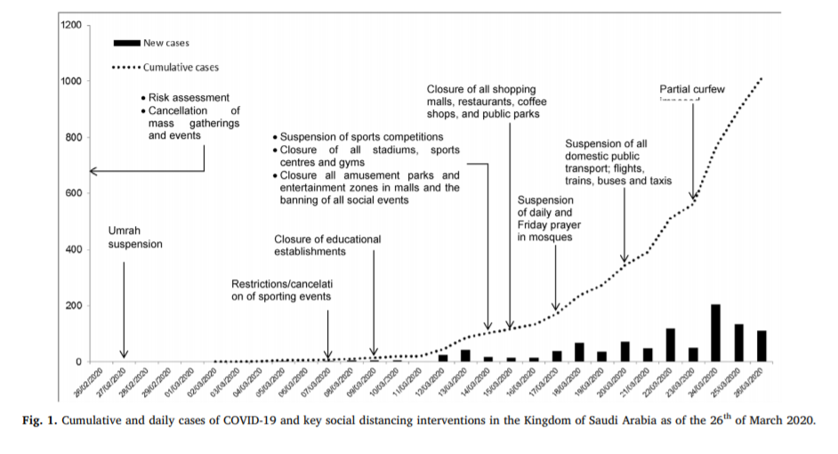
Kingdom of Saudi Arabia Covid-19 measures:

Slide 5
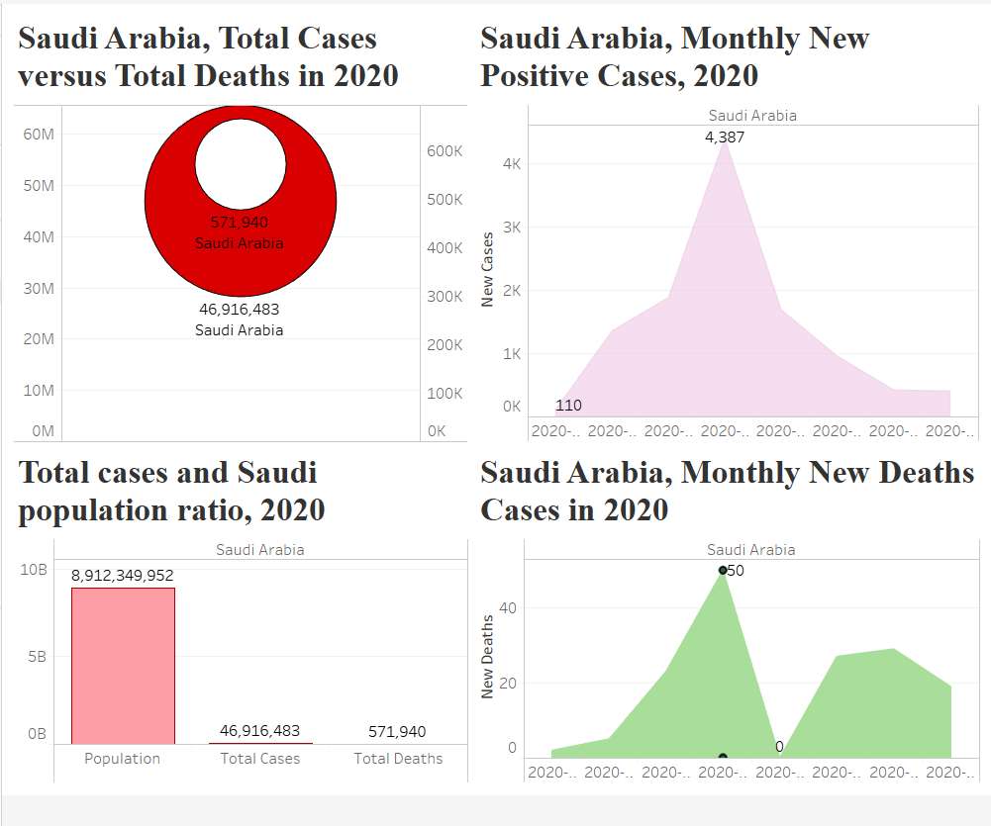
The Dashboard, indicating key metrics related to the impact of COVID-19 in Saudi Arabia.

Slide 6
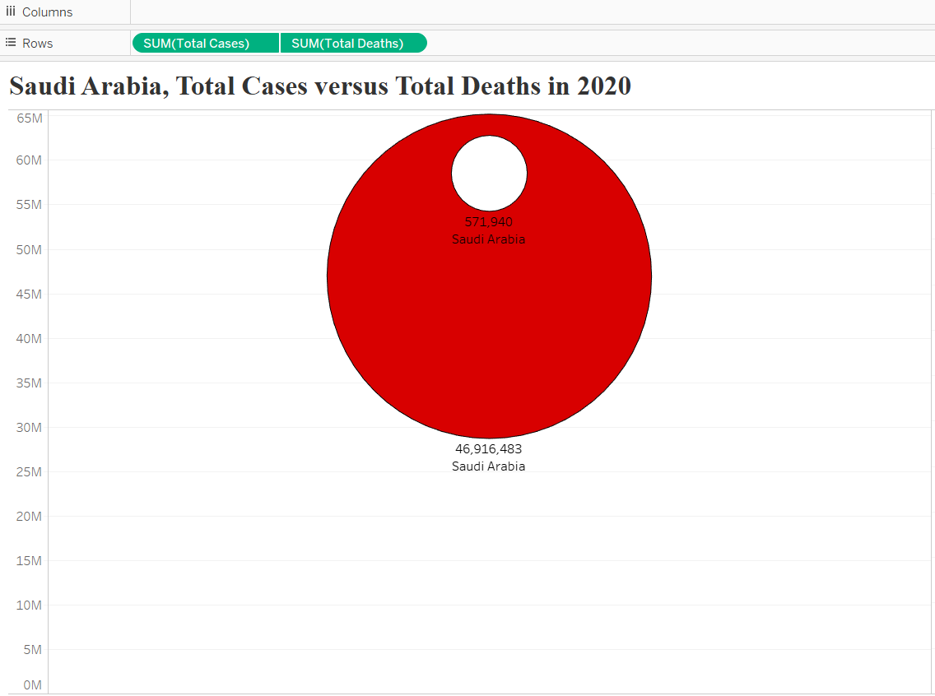
Saudi Arabia: TOTAL CASES: 46,916,483 Total deaths: 571,940

Slide 7
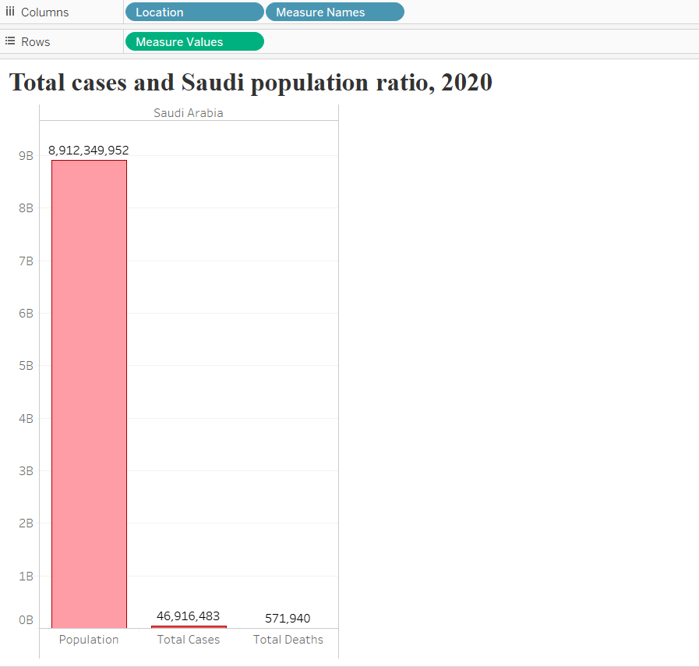
The Ratio of total cases to Saudi Population: 0.005264 The ratio of total death to total cases: 0.0122 The ratio of totals deaths to Saudi population: 0.0000642

Slide 8
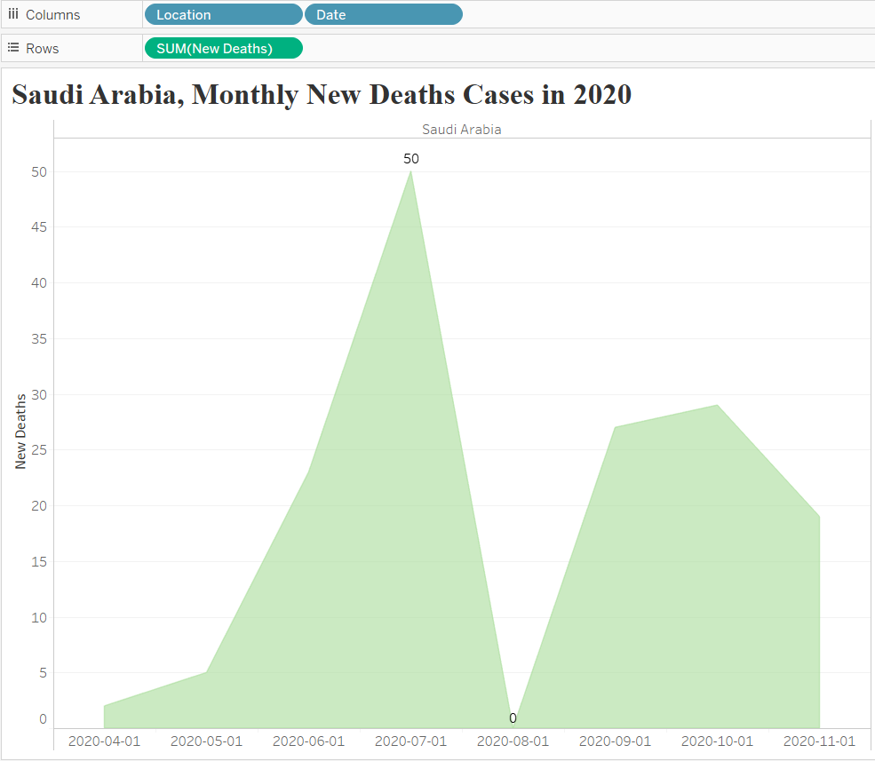
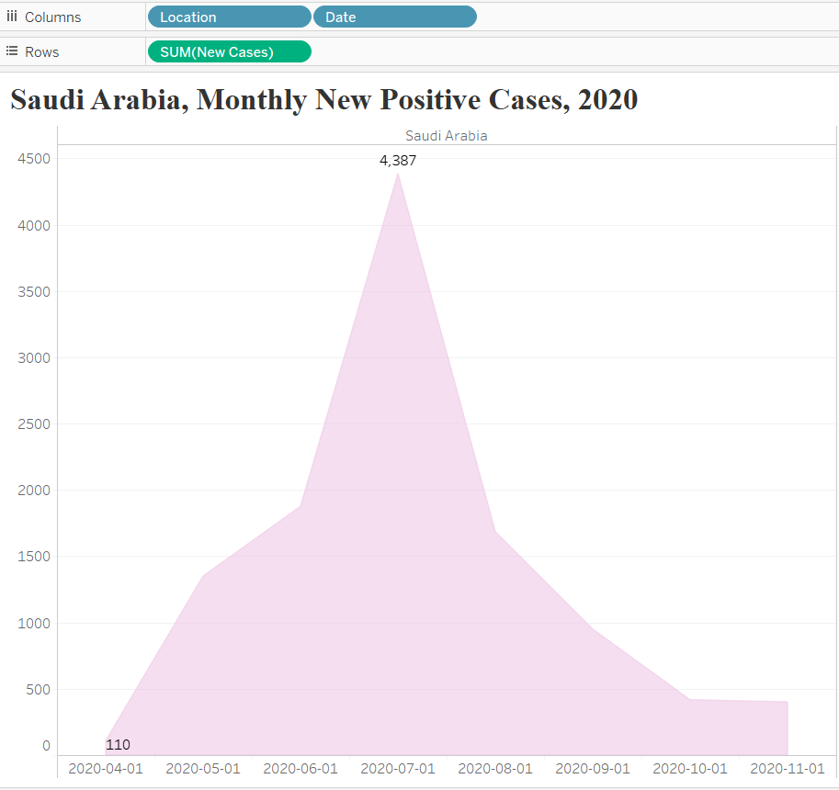
The new positive cases on monthly basis are getting relatively lower and more stable starting august 2020 onwards.

Slide 9

Kingdom of Saudi Arabia Government and institution measures in response to COVID-19
Saudi Government has announced to pay 60% of the salaries of Saudi employees working in the Private sector for a period of three months with a ceiling of USD 2.39 billion.
On 20 March, Saudi Arabia announced $18.6 billion in fiscal initiatives. These include an exemption from the expat levy, extending for 3 months without charge.
Providing concessional financing for SMEs in an amount up to (13.2 billion riyals), by granting facilities from banks and finance companies to the SME sector in order to support business continuity and growth in this sector during the current stage, and that contributes to supporting economic growth and maintaining The levels of employment in these establishments

Slide 10
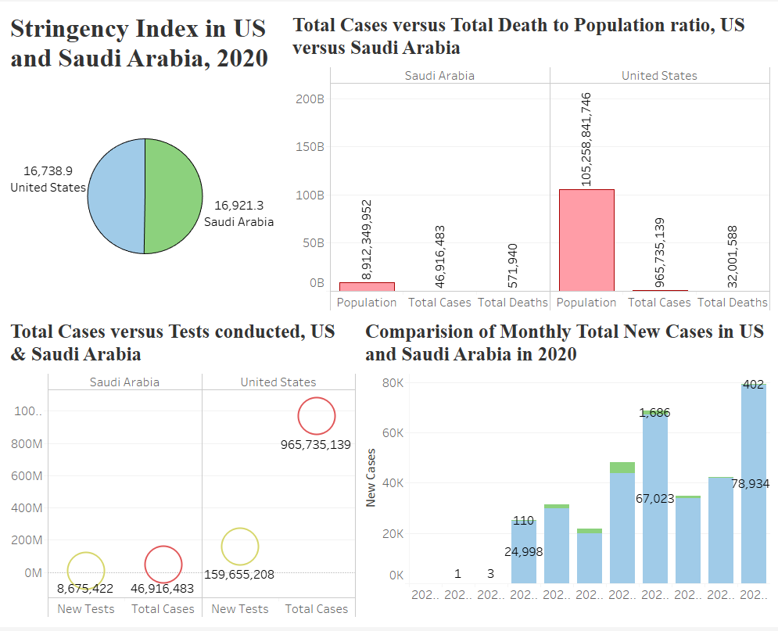
Comparative analysis of two countries such as Saudi Arabia and united states in experience of key metrics related to the impact of COVID-19.

Slide 11

United states of America, COVID-19 STATISTICS, 2020: the first case of COVID-19: on January 20, 2020. Cancellation of sporting, cultural and entertainment events: on March 12, 2020. The first date of lockdown: march 19, 2020. Presidential Proclamation on travel to the United States from and transiting through Europe: March 11, 2020.

Slide 12
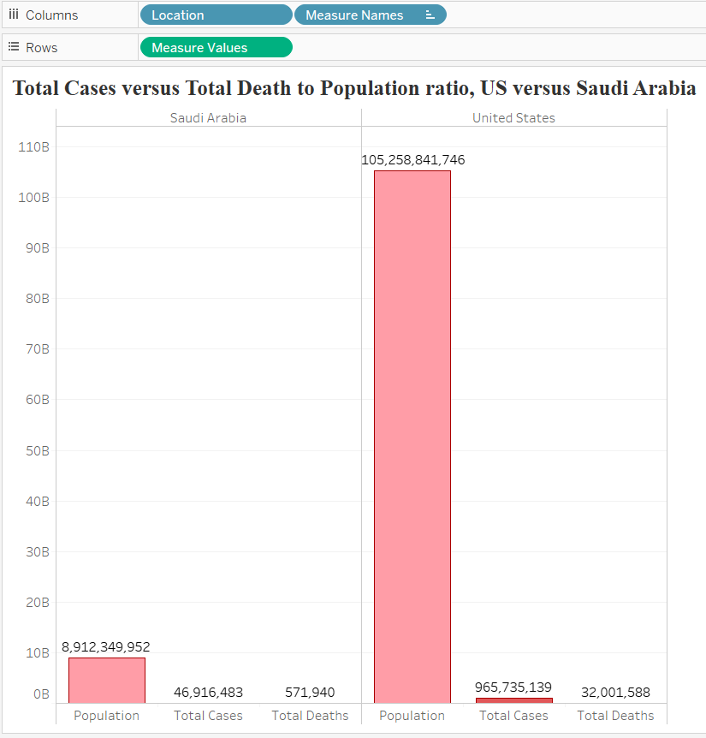
Comparative country analysis: Total cases to population ratio In Saudi Arabia: 0.005264 united states: 0.00924 Total deaths to total cases ratio in Saudi Arabia: 0.0122 United states: 0.0331

Slide 13
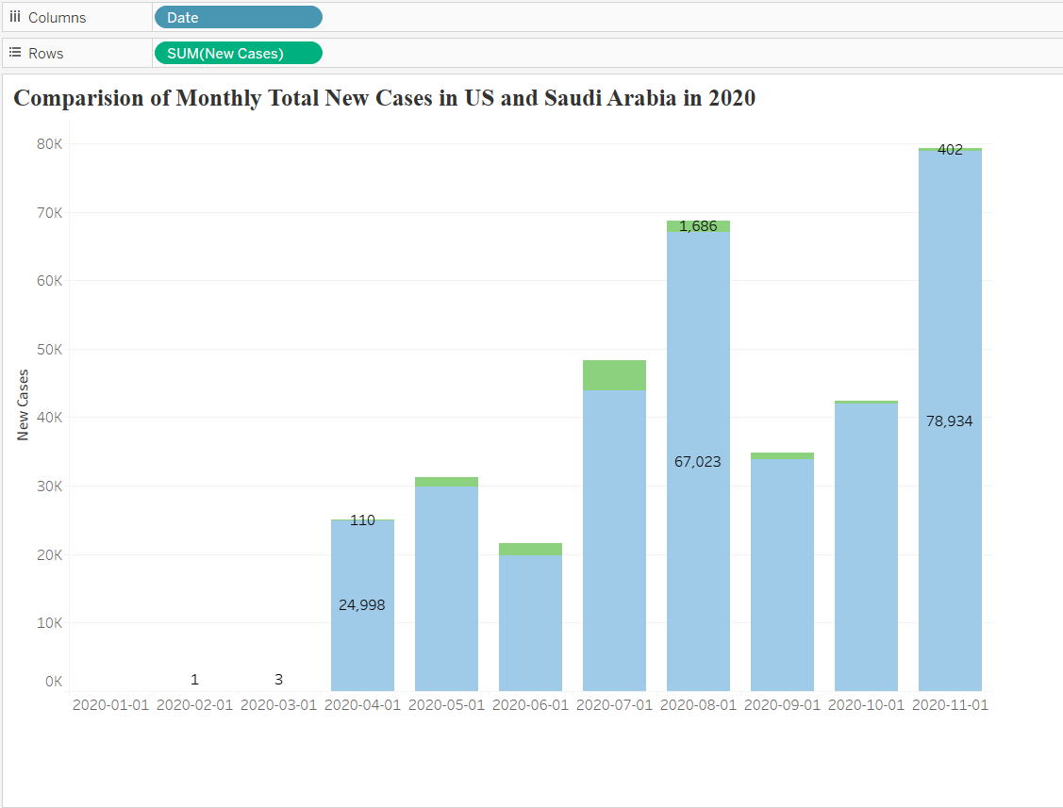
Total number of new cases on monthly basis, USA & kingdom of Saudi Arabia

Slide 14

United states of America Government and institution measures in response to COVID-19
Phase 1 (March 6, 2020)–Coronavirus Preparedness and Response Supplemental Appropriations Act,
$8.3 billion in aid: Initial funding and support for vaccine development
Phase 2 (March 18, 2020)–Families First Coronavirus Response Act
$105 billion in aid: Paid sick leave, unemployment, and food assistance
Phase 3 (March 27, 2020)–Coronavirus Aid, Relief, and Economic Security Act, (CARES Act)
est. $2.3 trillion in aid: Major individual and business assistance and economic stimulus, the largest package addressing COVID-19 to date.

Slide 15
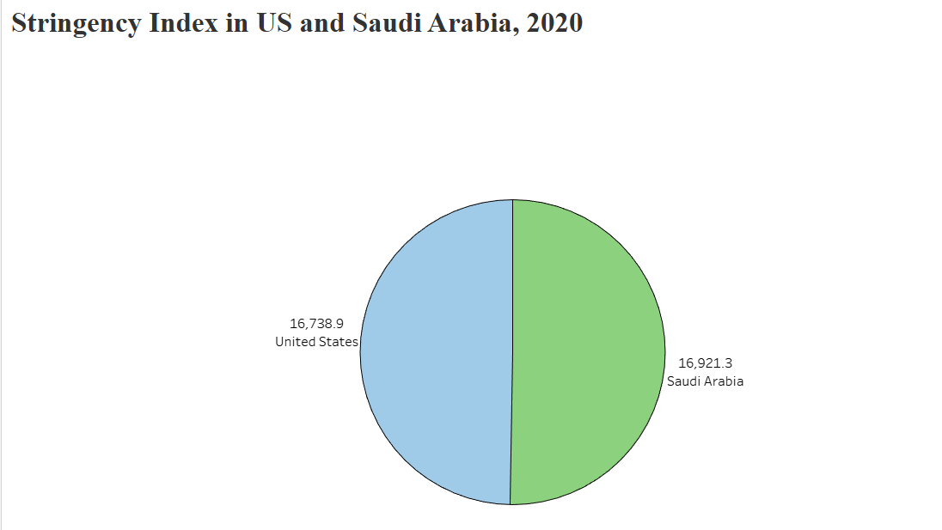

Slide 16
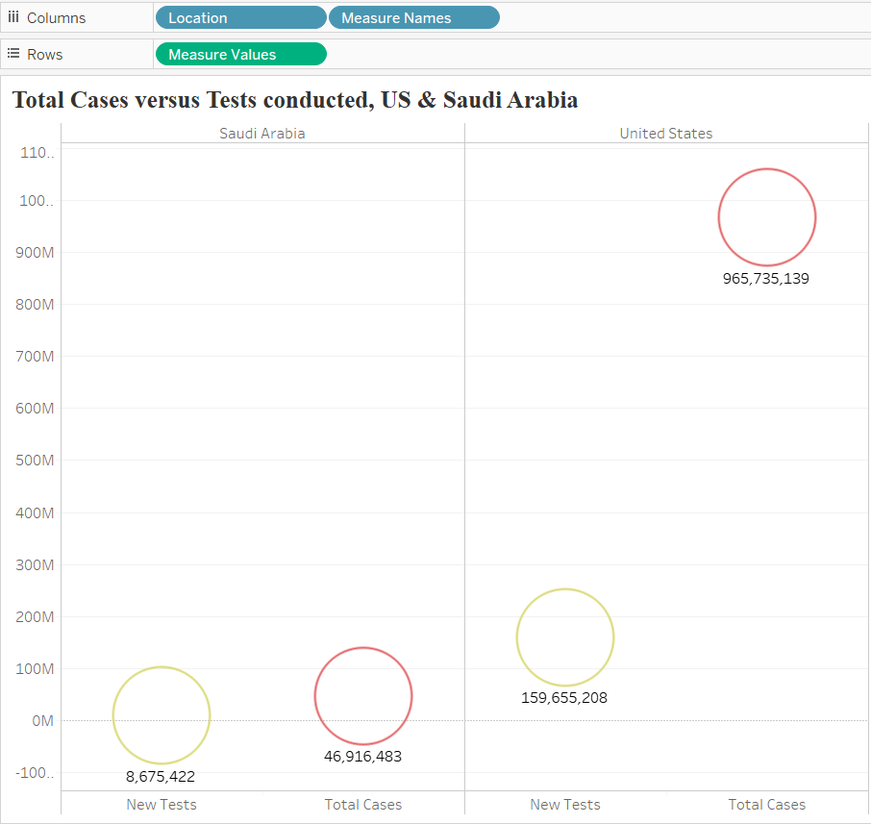

Slide 17
Policy recommendations: Social distancing at its various levels Economic stimulus measures Employment-related measures Funding for Lending Monetary Policy

Slide 18
Thank you so much for attention! ^_^

